Slide 1

Green Pace
Security Policy Presentation
Developer: Monica Nguyen

Slide 2

OVERVIEW: DEFENSE IN DEPTH
Defense-In-Depth (DiD) is a security strategy that uses multiple layers of protection to safeguard systems, data, and users.
Involves multiple security controls in each layer to minimize attack surfaces.
This policy serves as the “foundational layer” for current and future Green Pace applications.

Slide 3
THREATS MATRIX
PRIORITY
LIKELIHOOD
 | Low | Medium | High
Likely |  | STD-005-CPP | STD-004-CPP
Probable |  | STD-003-CPP STD-007-CPP STD-010-CPP | STD-002-CPP
Unlikely | STD-006-CPP | STD-008-CPP STD-009-CPP | STD-001-CPP

Slide 4
10 PRINCIPLES
# | Coding Principle | Coding Standard
1 | Validate Input Data | STD-008-CPP
2 | Heed Compiler Warnings | STD-002-CPP, STD-010-CPP
3 | Architect and Design for Security Principles | STD-009-CPP
4 | Keep It Simple | STD-001-CPP, STD-006-CPP
5 | Default Deny | Encryption Policy
6 | Adhere to the Principle of Least Privileges | Tripe-A Policy
7 | Sanitize Data Sent to Other Systems | STD-004-CPP
8 | Practice Defense in Depth | STD-005-CPP
9 | Use Effective Quality Assurance Techniques | STD-003-CPP
10 | Avoid Unchecked Exceptions | STD-007-CPP

Slide 5
CODING STANDARDS
Rule | Name | Severity | Likelihood | Remediation Cost | Priority | Level
STD-001-CPP | Obey the one definition rule | High | Unlikely | Medium | High | 2
STD-002-CPP | Do not read uninitialized memory | High | Probable | High | High | 5
STD-003-CPP | Use valid references, pointers, and iterators to reference elements of a basic_string | High | Probable | Medium | Medium | 3
STD-004-CPP | Do not construct SQL queries using unsanitized/untrusted input | High | Likely | Low | High | 5
STD-005-CPP | Do not use freed memory | High | Likely | Medium | Medium | 4
STD-006-CPP | Avoid side effects in arguments to unsafe macros | Low | Unlikely | High | Low | 1
STD-007-CPP | Handle all exceptions | Low | Probable | Medium | Medium | 3
STD-008-CPP | Do not cast an out-of-range enumeration value | Medium | Unlikely | Medium | Medium | 3
STD-009-CPP | Close files when they are no longer needed | Medium | Unlikely | Medium | Medium | 4
STD-010-CPP | Value returning functions must return a value from all exit paths | Medium | Probable | High | Medium | 4

Slide 6
ENCRYPTION POLICIES
Encryption at Rest protects stored data
  Vulnerabilities: Hard drives, computers, on-premise and cloud databases and assets, etc.
  Policy: Use AES-256 to convert plaintext to ciphertext, readable only with a 256-bit symmetric key
Encryption in Flight protects data in transit
  Vulnerabilities: Data traveling across networks between systems, users or services
  Policy: Use TLS (Transport Layer Security) to establish encrypted tunnels between client and server
Encryption in Use protects data in use during active processing
  Vulnerabilities: Data that a system, user, or service, is actively reading, modifying, or computing
  Policy: Protect workloads with TEE, FHE, or MPC technologies

Slide 7
TRIPLE-A POLICIES
Authentication: the process of verifying credentials of a user, system, or entity. User login should require the system to check credentials inputted before granting access.
  Passwords, hardware keys, multi-factor authentication (MFA), or biometric (fingerprint, face recognition) data
Authorization: the process of determining what an authorized user can do and what information can be accessed based on roles and permissions
  Least privileges principle (Principle #6), role-based access controls (Principle #5), access control management
Accounting: the tracking of user activities within a system
  Log files, session tracking, usage audits tracking details such as user login, data transfers, user privilege changes, etc.

Slide 8
Unit Testing
The process of testing the smallest functional unit of code.
Unit tests created with Google Test (GTest, https://github.com/google/googletest)

Slide 9
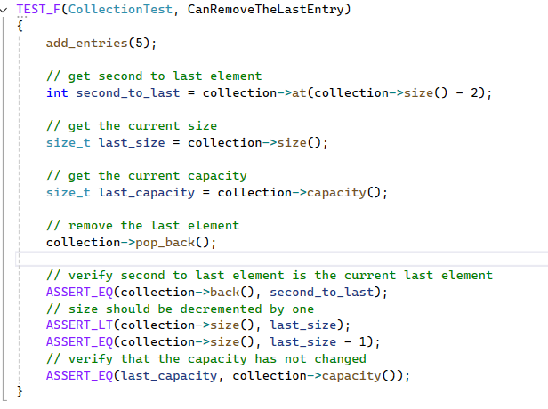
CanRemoveTheLastEntry
Test to verify that a valid range shrinks correctly (STD-003-CPP)
Results:

Slide 10
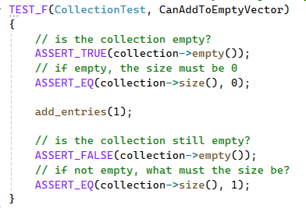
CanAddToEmptyVector
Tests whether valid elements exists after insert (STD-003-CPP)
Results:

Slide 11
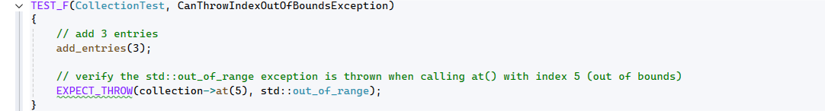
CanThrowIndexOutOfBoundsException
Verify out of range exception is thrown when calling an index outside the valid range (STD-007-CPP)
Results:

Slide 12
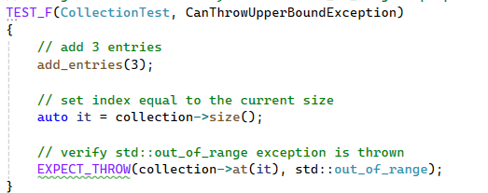
CanThrowUpperBoundException
Test to verify access an index equal to the size throws an exception (STD-007-CPP)
Results:

Slide 13

AUTOMATION SUMMARY

Slide 14
TOOLS
  DevSecOps (Development, Security, Operations)
    A model for developing software by embedding security in the full Software Development Lifecycle (SDLC)
    Security checks added at each phase of the SDLC
    Includes security team, in the addition to development and operations teams, from the start of the process
    Allows early detection of vulnerabilities
  Tools:
    Build
      Clang-Tidy – C/C++ static analysis and linting tool integrated into the developer IDE
        AddressSanitizer – Compiler tool to detect memory issues
        MemorySanitizer – Compiler tool to detect uninitialized values
      Cppcheck - Static code analyzer (Open-source)
      CodeSonar – Static code analyzer (Proprietary)
    Health Check
      OWASP ZAP – Penetration testing tool
    Monitor and Detect
      Parasoft C/C++test – Automated test suite

Slide 15
RISKS AND BENEFITS
Problems & Solutions
Fixes are costly if vulnerabilities are found late in production
Inconsistent security practices across various teams
Act Now vs. Wait
Now: upfront costs in time, tools, and training, but less vulnerability exposure and cheaper to fix
Wait: saves short-term effort but risks technical debt and breach risk grows
Strategy Gaps & Risks
Not all standards can be automated (e.g., logic issues, design flaws)
False positives can lead to alert fatigue
Next Steps
Solution: Enforce coding standards with automated checks in the DevSecOps pipeline
Over-reliance on tools gives false sense of security
Integrate static/dynamic analysis into build
Train Dev, Security, and Ops teams on security standards and approved tools
Add manual review in addition to automation
Perform threat modeling
Review policy regularly and update as needed

Slide 16
RECOMMENDATIONS
Current security policy covers vulnerabilities in pre-production and production, but does not explicitly cover incident response protocol after an attack has occurred
Formal internal communications after an attack should be established between departments
Define a formal reporting format to document the attack to ensure consistent and correct information
  How the attack happened
  Type of attack
  Impact on clients and/or services
  Assets affected
  Victims identified
Define a process to return the system to the last secure, stable environment
Define data recovery process
Understand Green Pace’s ethical obligations and communicate with clients of an attack

Slide 17
RECOMMENDATIONS
Case Study: Fort Smith Computer System Hack
  5.7 TB of city data was stolen by ransomware group, Interlock
  Breach was traced to Fort Smith Police Department systems and spread to other city departments
  Sensitive data, including investigative data, water-system data, and Social Security numbers were stolen
  Response to the attack was slow and full system restoration confirmation has not been announced
Impact:
  Disruption to city operations
  Increased risks of identity theft and doxxing
  Public trust diminished over time → increased pressure among city officials

Slide 18
CONCLUSIONS
Adopt the 10 coding standards, prioritizing the highest-risk rules first
  STD-002-CPP, STD-004-CPP, STD-005-CPP
Enforce the standards through DevSecOps automation
  Static analysis (Clang-Tidy, Cppcheck) and sanitizers (AddressSanitizer, MemorySanitizer) on every build
  Require positive and negative unit tests (GTest) before merging code
Adopt encryption and Triple-A policies as standard practice
  AES-256 at rest, TLS in flight, protected workloads in use
  MFA, least privilege, and audit logging for all systems
Adopt an incident response plan to close the policy gap
  Formal reporting, stable environment and data recovery, timely communication between departments and clients
Review and update the policy regularly as new threats emerge

Slide 19
REFERENCES
Breach History. (2026, September 24). Fort Smith Breach: City Confirms PD Data Theft. Breach History. https://breachhistory.com/blog/fort-smith-arkansas-interlock-data-theft-september-2026.
Chachak, E. (2021, November 30). Post-Cyber Attack: 7 Critical Steps To Take Toward Full Recovery. CyberDB. https://www.cyberdb.co/post-cyber-attack-7-critical-steps-to-take-toward-full-recovery/.
Puttoju, K. (2025, July 12). AAA: The Triple-Pillar Framework of Modern Access Control. Medium. https://medium.com/@karthik.puttoju9/aaa-the-triple-pillar-framework-of-modern-access-control-d3ad08e63836.
Software Engineering Institute. (n.d.). How this coding standard is organized. SEI CERT C++ Coding Standard. https://cmu-sei.github.io/secure-coding-standards/sei-cert-cpp-coding-standard/front-matter/introduction/how-this-coding-standard-is-organized.
Tilley, M. (2026, September 16). Interlock claims responsibility for Fort Smith computer system attack. Talk Business & Politics. https://talkbusiness.net/2026/09/interlock-claims-responsibility-for-fort-smith-computer-system-attack/.
Wachstock, M. (2026, May 23). How Encryption Works: Data at Rest vs In Transit vs In Use. Duality. https://dualitytech.com/blog/data-at-rest-vs-in-transit-vs-in-use/#encryption-at-rest-aes-and-storage-protection.

